Slide 1



Hospitality Analysis
View in Power BI
Last data refresh:
5/20/2024 8:04:49 PM UTC
Downloaded at:
5/20/2024 8:07:40 PM UTC

Slide 2
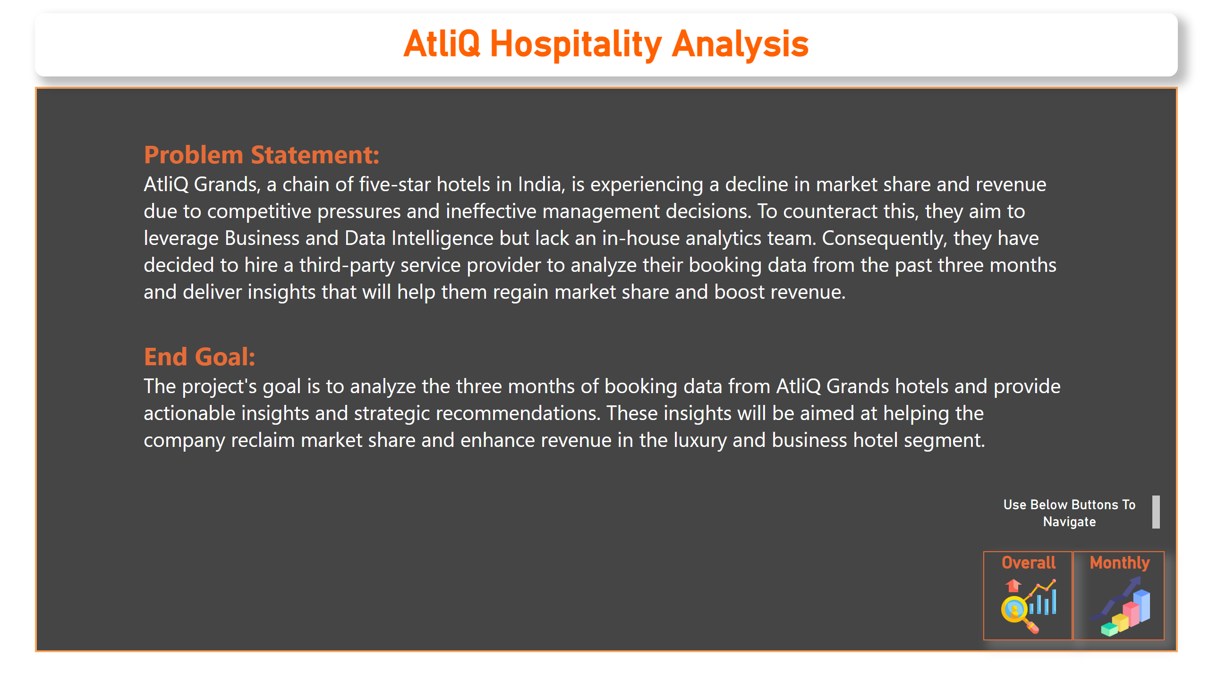
Home
Notes:
shape
No alt text provided
textbox
No alt text provided
shape
No alt text provided
shape
No alt text provided
image
No alt text provided
textbox
No alt text provided
actionButton
No alt text provided
actionButton
No alt text provided
actionButton
No alt text provided
textbox
No alt text provided
Overall
No alt text provided
Monthly
No alt text provided
textbox
No alt text provided

Slide 3
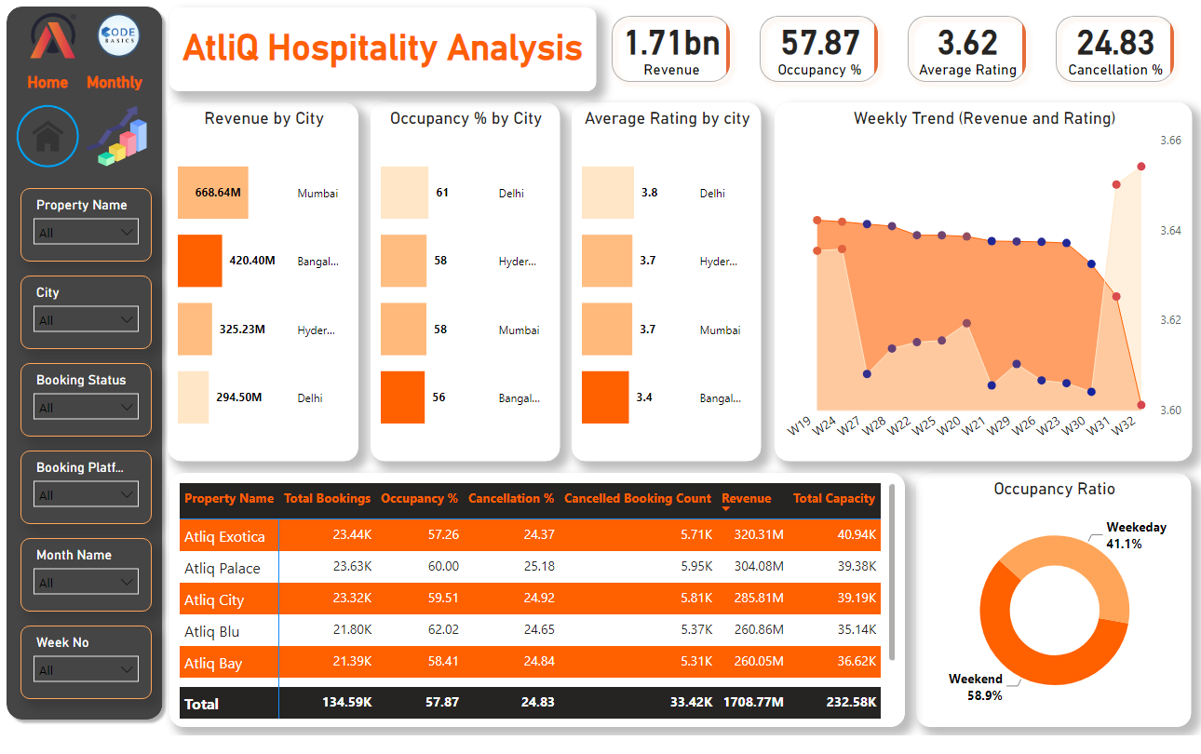
Overall
Notes:
image
No alt text provided
image
No alt text provided
Monthly
No alt text provided
Home
No alt text provided
shape
No alt text provided
slicer
No alt text provided
slicer
No alt text provided
slicer
No alt text provided
slicer
No alt text provided
slicer
No alt text provided
slicer
No alt text provided
cardVisual
No alt text provided
Weekly Trend (Revenue and Rating)
No alt text provided
barChart
No alt text provided
Occupancy % by City
No alt text provided
Revenue by City
No alt text provided
pivotTable
No alt text provided
Occupancy Ratio
No alt text provided
textbox
No alt text provided

Slide 4
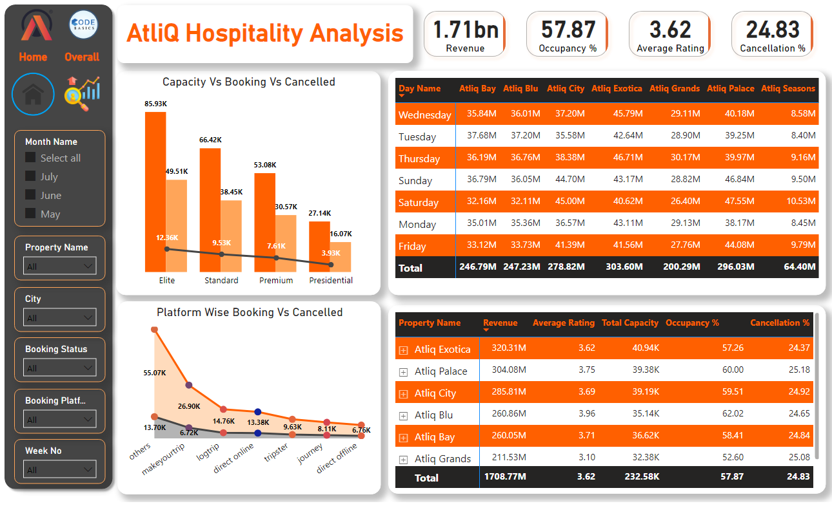
Monthly
Notes:
Overall
No alt text provided
Home
No alt text provided
shape
No alt text provided
slicer
No alt text provided
slicer
No alt text provided
slicer
No alt text provided
slicer
No alt text provided
slicer
No alt text provided
slicer
No alt text provided
image
No alt text provided
image
No alt text provided
cardVisual
No alt text provided
Capacity Vs Booking Vs Cancelled
No alt text provided
textbox
No alt text provided
Platform Wise Booking Vs Cancelled
No alt text provided
Capacity Vs Booking Vs Cancelled
No alt text provided
Capacity Vs Booking Vs Cancelled
No alt text provided

